Slide 1

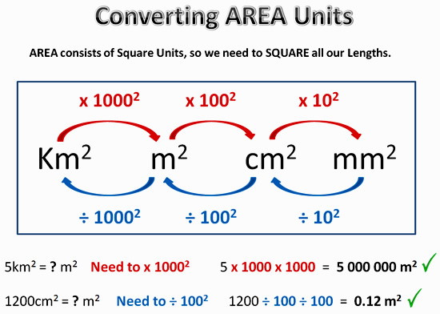
My Measurement Interactive Notebook
Name
Class
Teacher Mr Evans
Term 2 Semester 1
1

Slide 2
Contents
Glossary or Formula Page
Page
Date
Description
2
3

Slide 3
Tasks
24
7
30
Essential Question
Questions
Notes
Summary
6
7

Slide 4
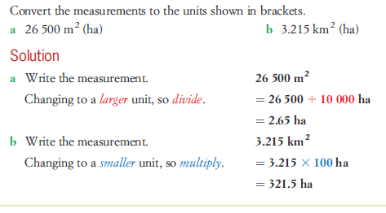
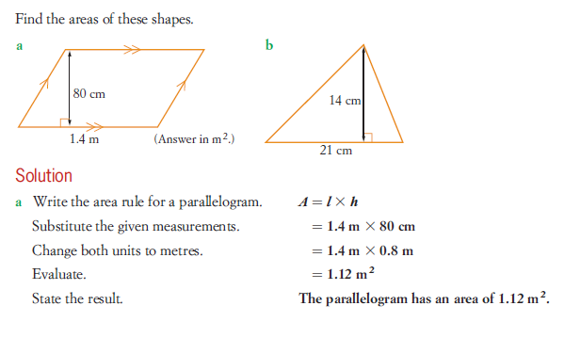
Converting Units of Measurement

Slide 5
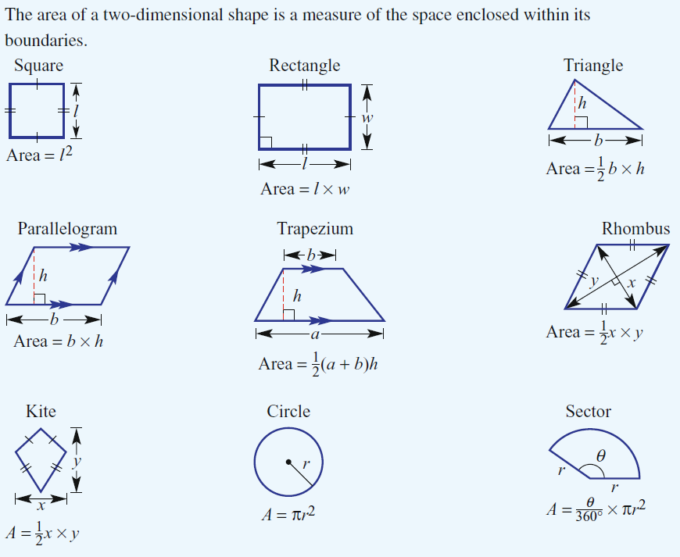
24
7
30
Date
Area
EQ – Describe how to find the area of different shapes.
How do we find the area of 2 dimensional shapes?
5

Slide 6
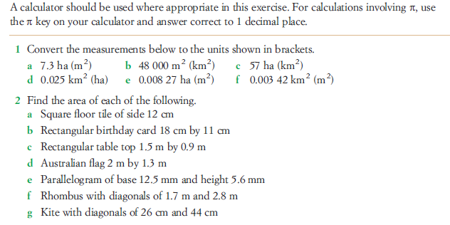
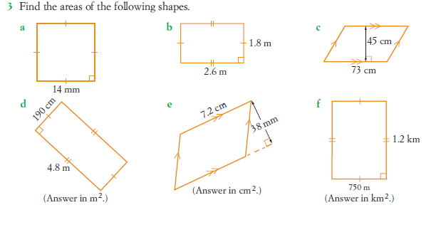

Slide 7
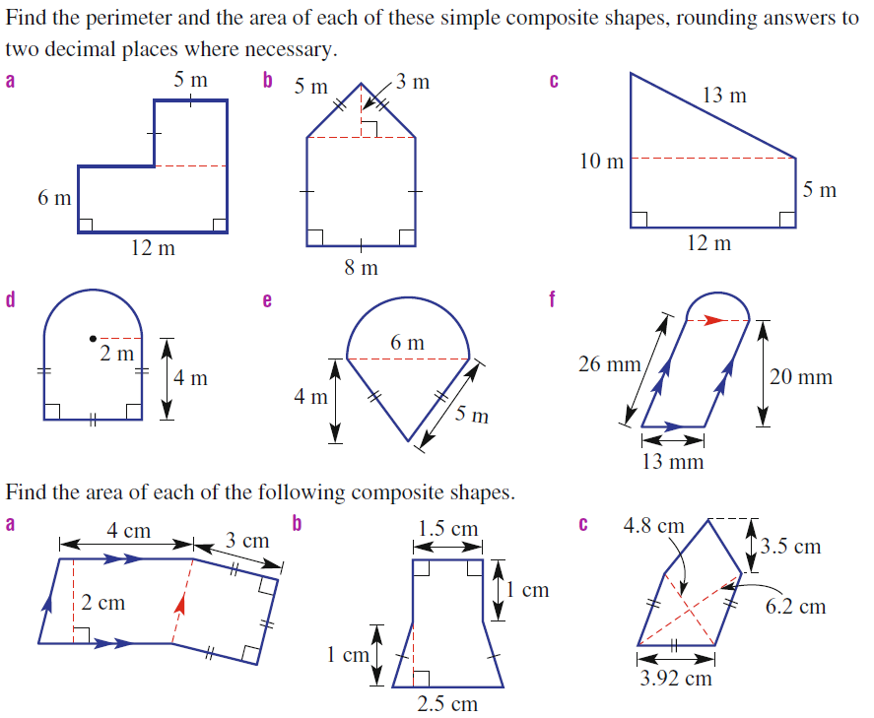
Questions

Slide 8
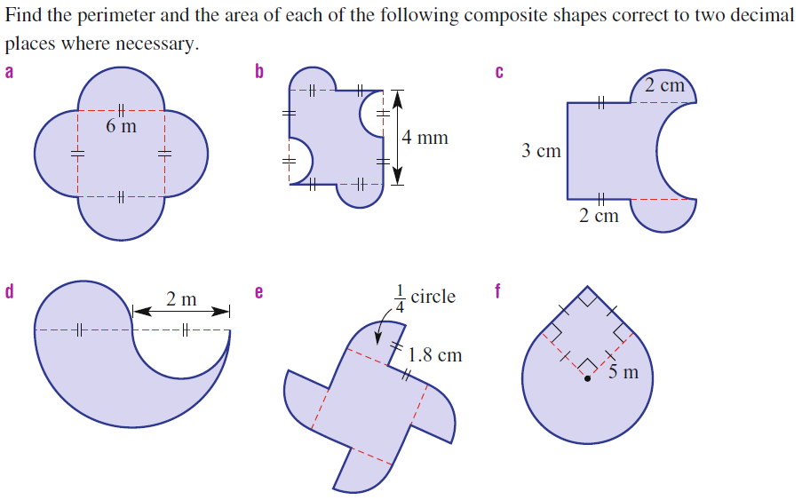
Questions

Slide 9
Notes Review
24, 7 ,30
Date
Title
Essential question
Notes complete
Notes complete with colour and diagrams
Questions completed
Contents page filed in
Formula page filled in

Slide 10
Homework
Review your notes and write a summary answering the essential question.

